Slide 1
New York Midnight Diner
Alaa TAAN
April 2019

Slide 2

Midnight Diner – The TV Show
Japanese anthology TV series
strange opening hours, 12 am to 7 am
IMDB rating 8.4
Streams on Netflix

Slide 3
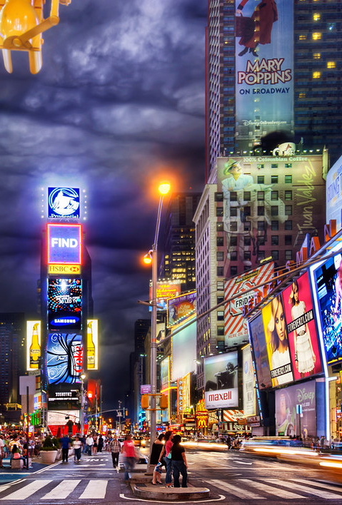
New York Midnight Diner
The popularity of the show inspired one businessman to open a midnight diner in Manhattan, New York.
This report aims to find the best location for such a diner.
The selected location must be in a neighborhood with active night life scene, and maybe with some Asian culture influences.

Slide 4
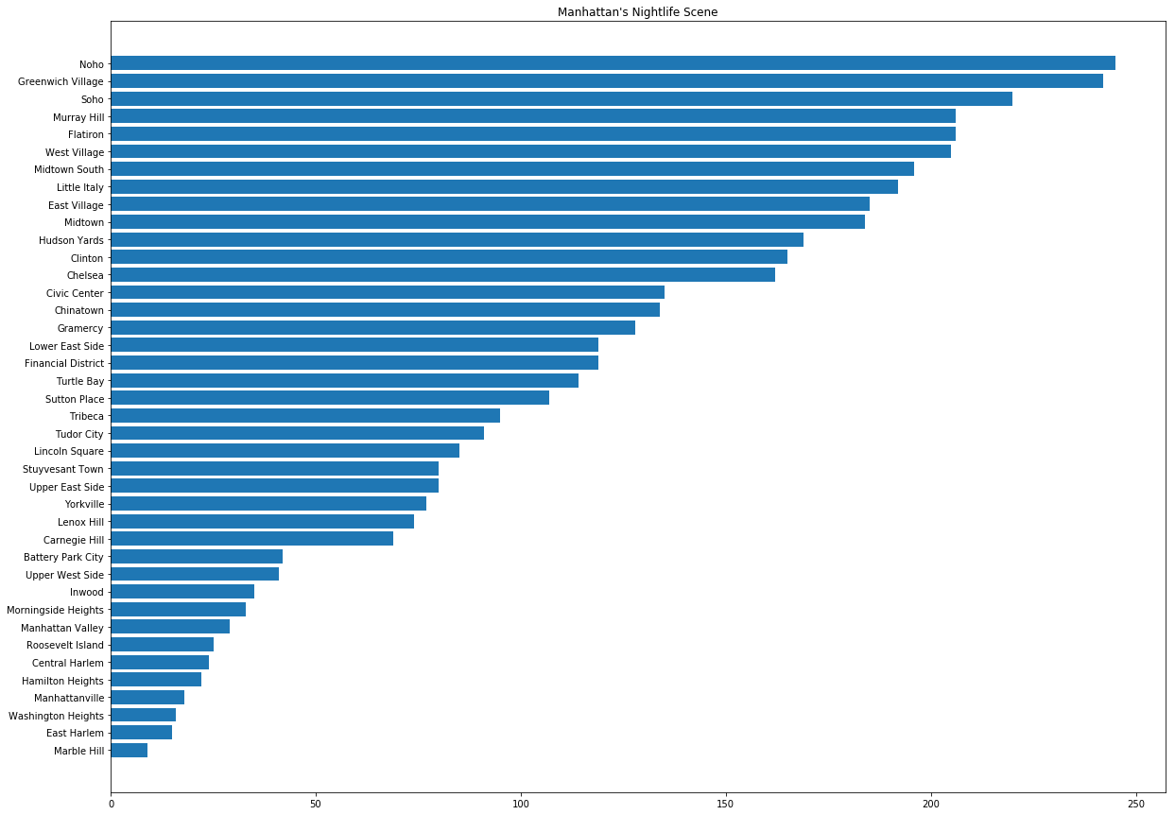
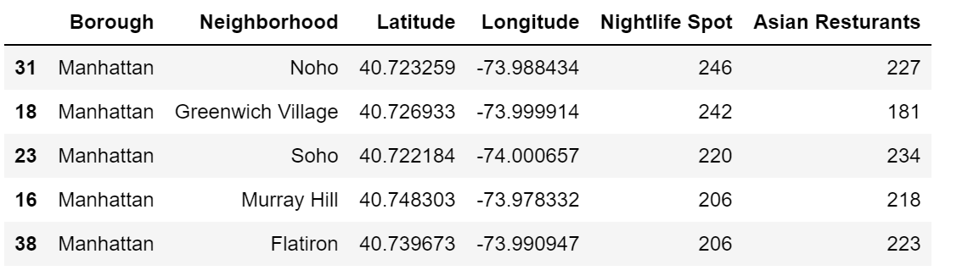
Manhattan's Nightlife Spots Count

Slide 5
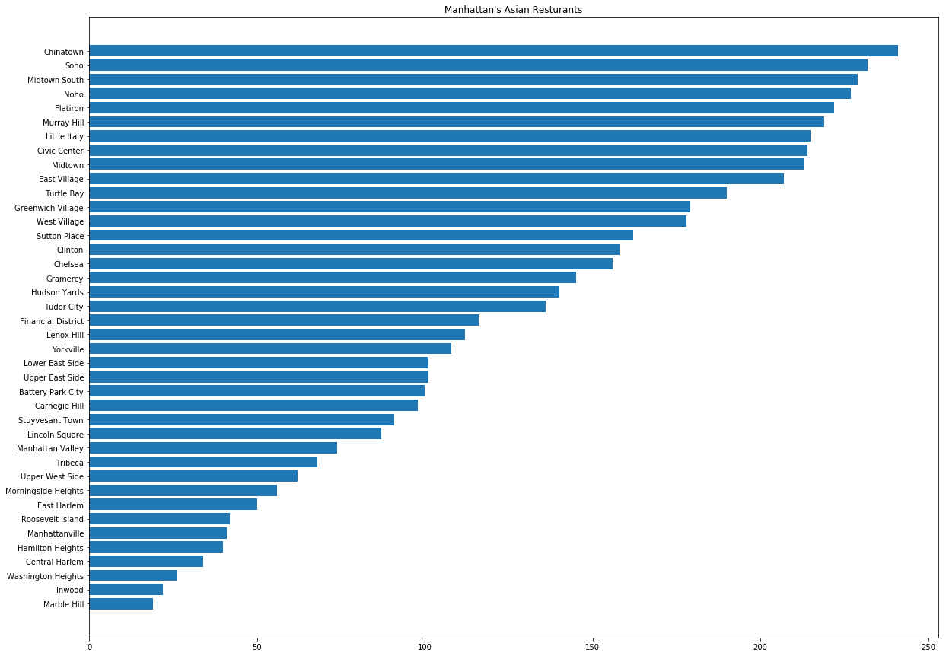
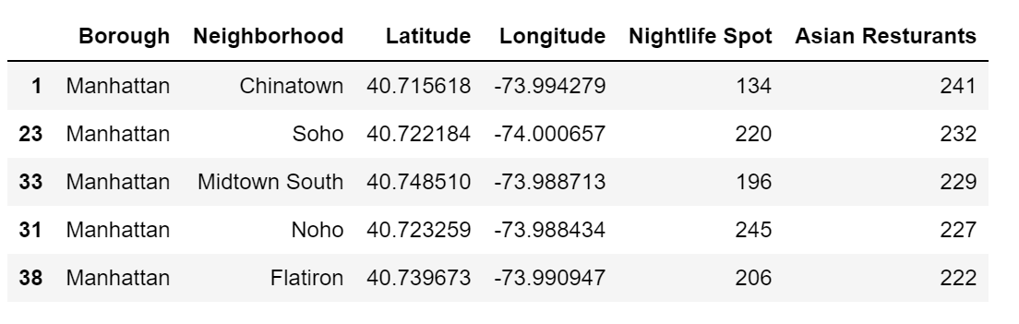
Manhattan’s Asian Restaurants Count

Slide 6
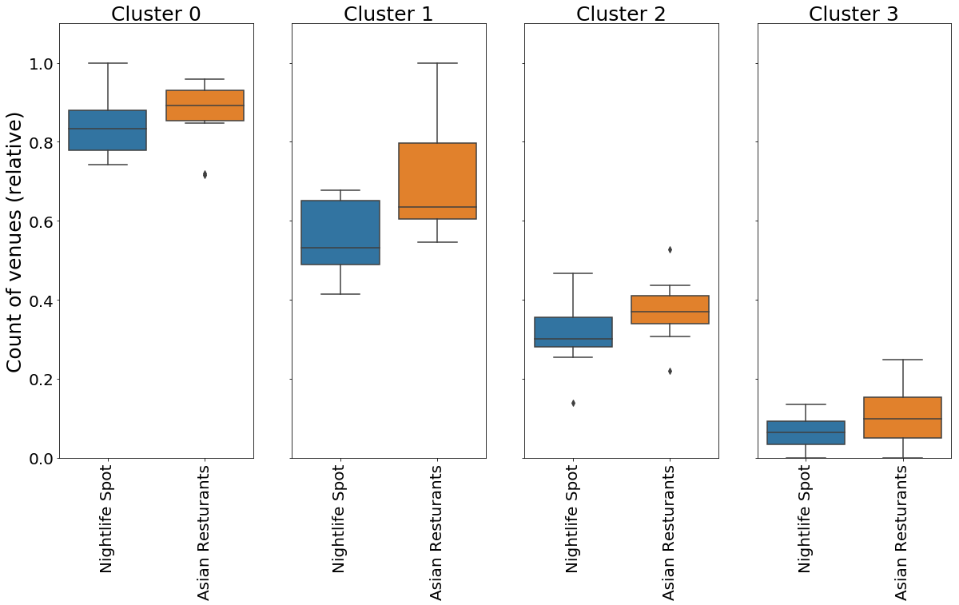
Clustering Neighborhoods

Slide 7
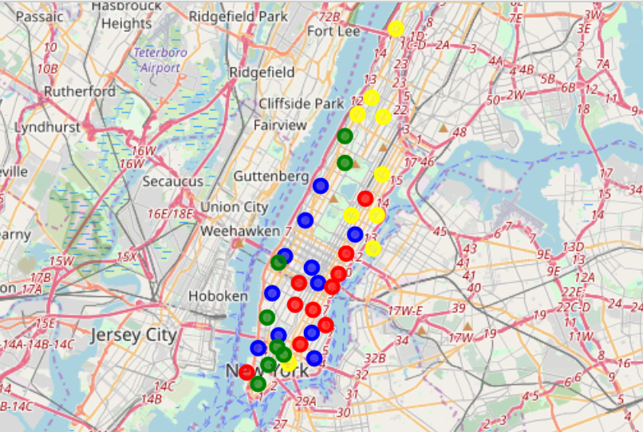
Clustering Neighborhoods

Slide 8
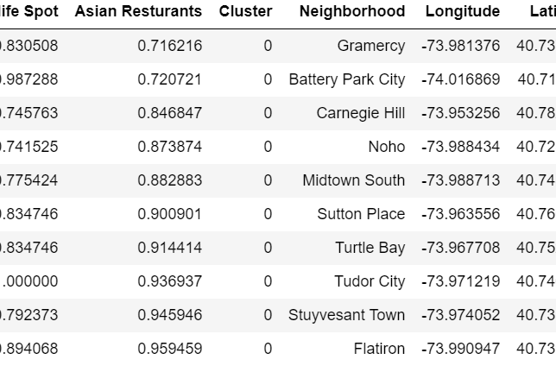
The Winning Cluster

